Slide 1
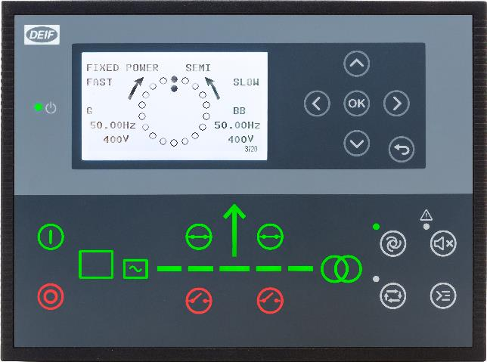
AGC 150
Basic knowledge

Slide 2
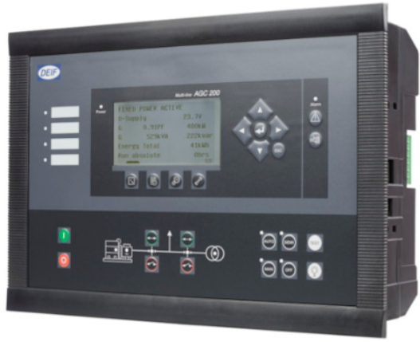
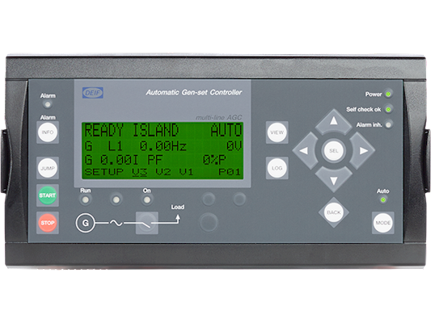
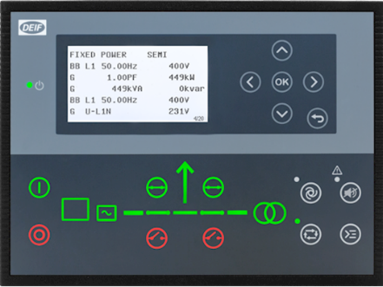
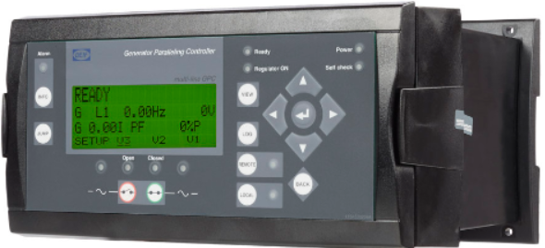
Synchronizing Controllers
GPC-3
Base mounted
Non-Power Management
AGC-4
Base mounted
Custom Power Management
AGC 150
Front mounted
Simple Power Management
AGC 200
Front mounted
Standard Power Management

Slide 3

Documentation
www.deif.com contains all manuals for the controllers

Slide 4
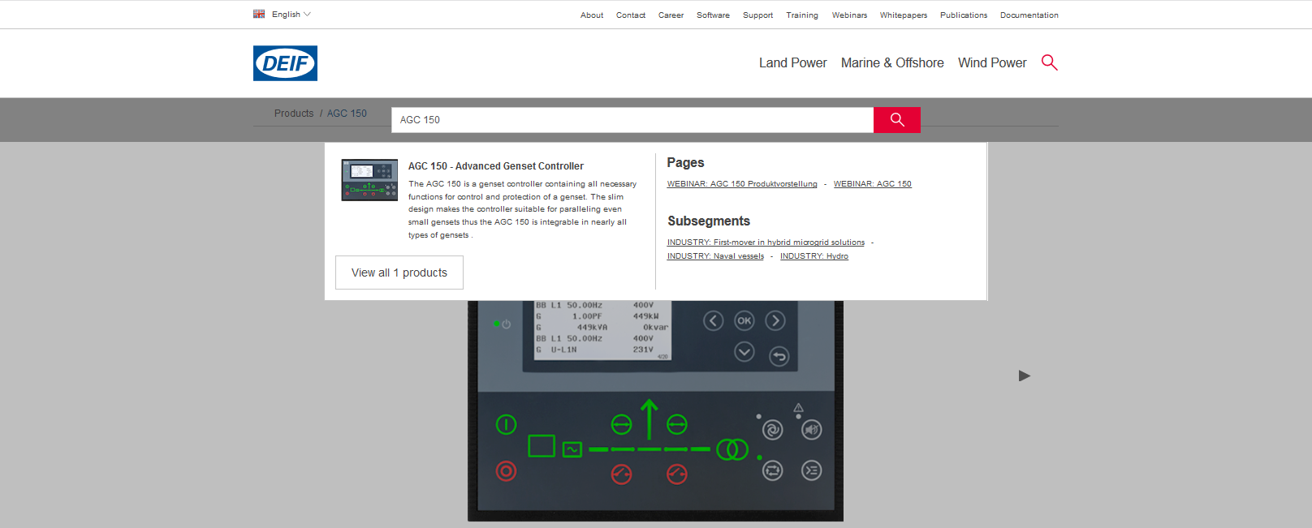
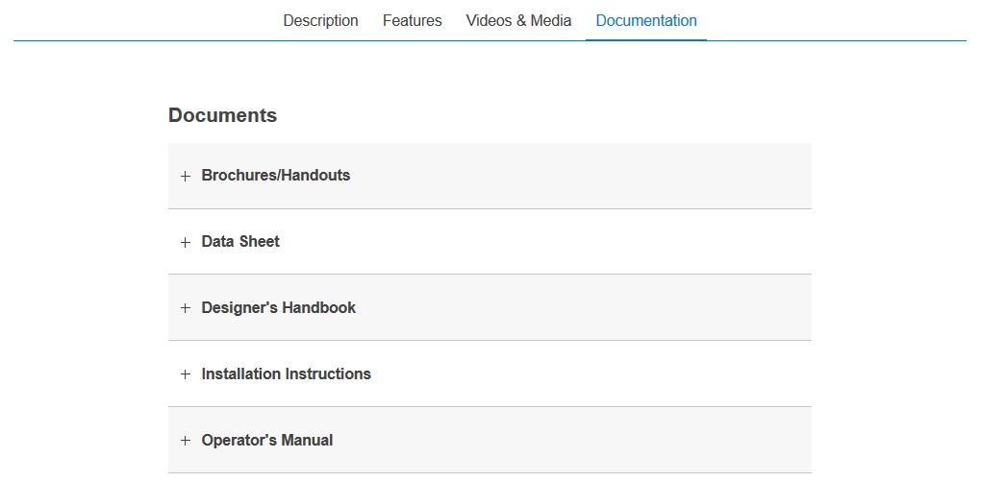
Documentation

Slide 5

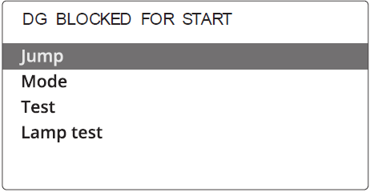
AGC 150
AUTO
SEMI AUTO
Shortcut Menu

Slide 6
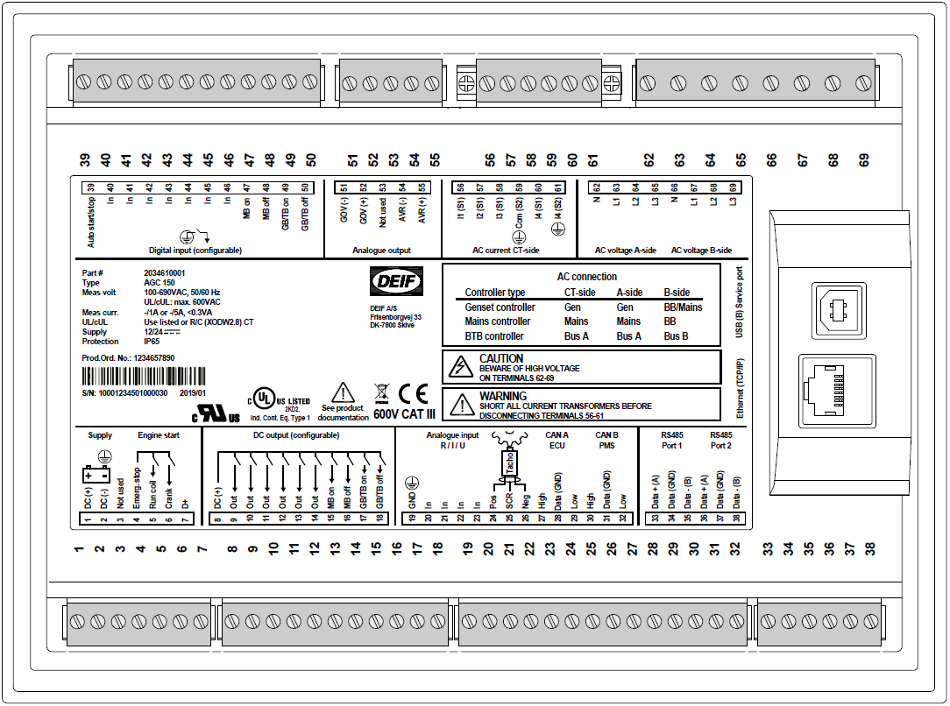
AGC 150
-10… 10VDC
GOV / AVR
PWM
USB
Ethernet TCP/IP
RS485 (2)
RS485 (1)
Additional I/O
ECU
DEIF PMS

Slide 7
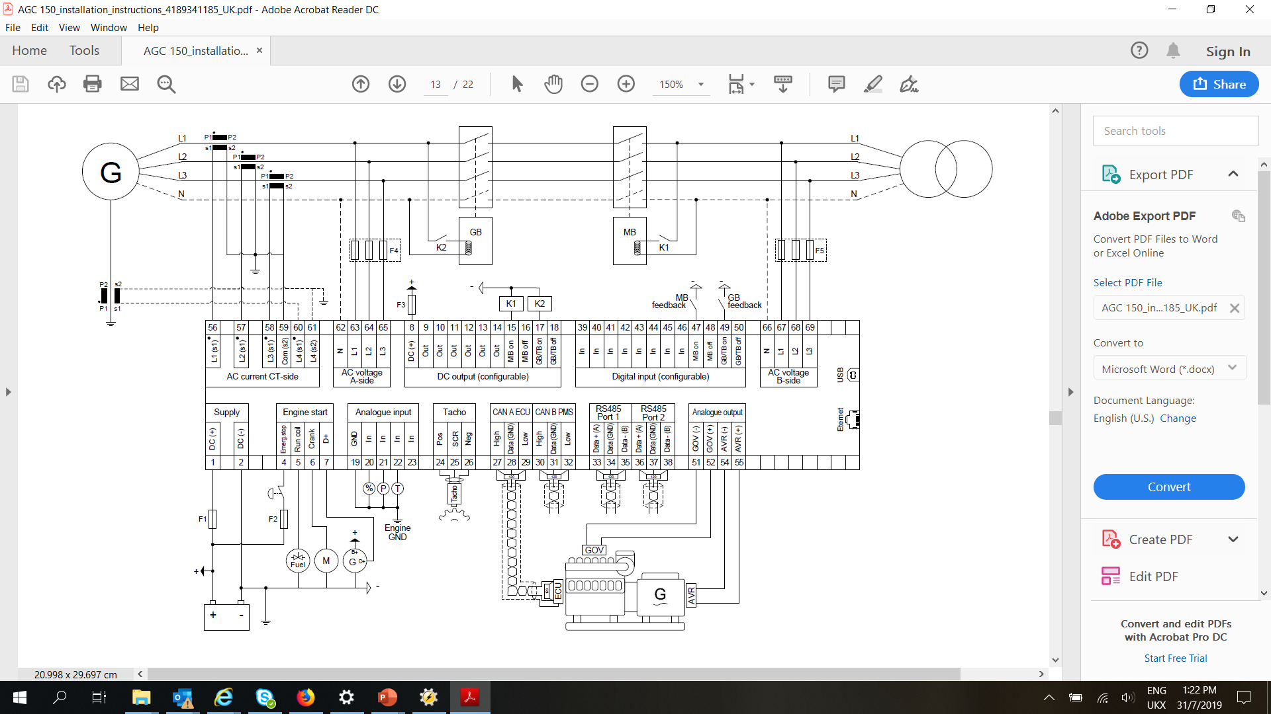
Typical wiring

Slide 8
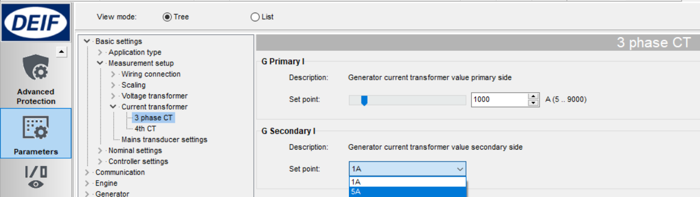
Basic Settings
Setup Current Transformer
Configurable CT

Slide 9
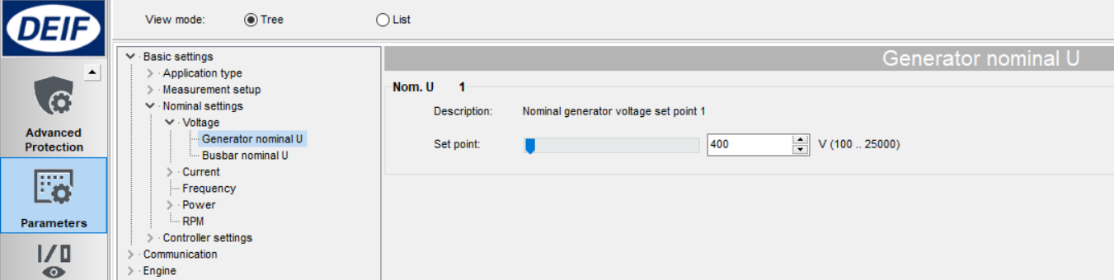
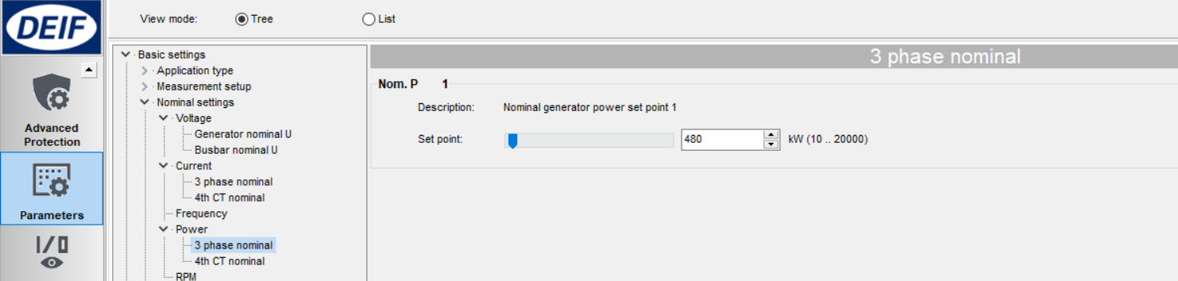



Basic Settings
Nominal settings
Configurable CT

Slide 10
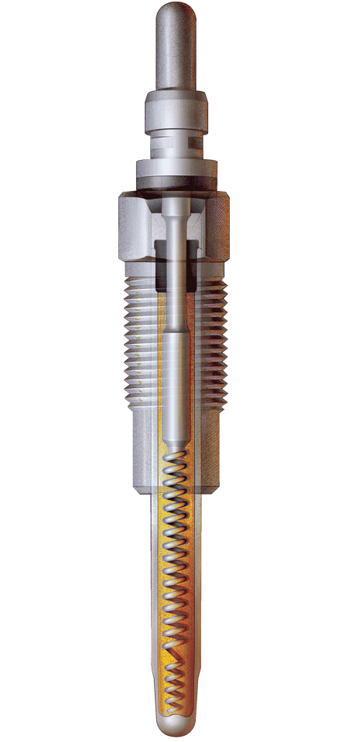
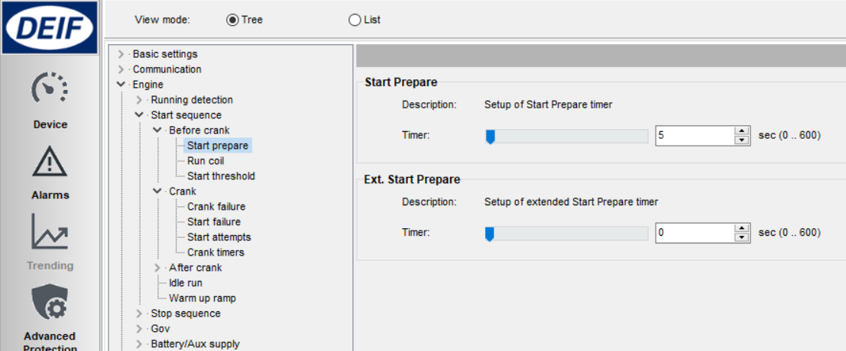
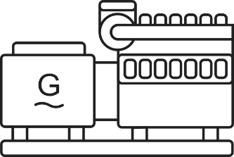
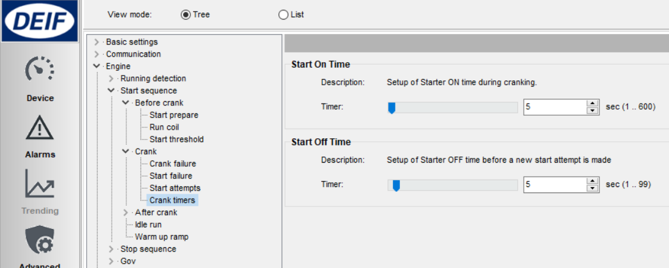
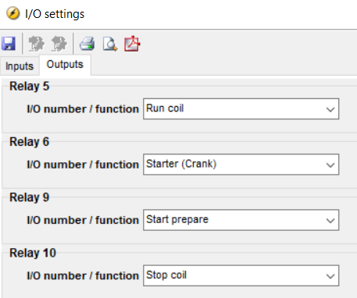
Start Sequence
1. Before starting, start prepare ON (Relay 9). Can be used to activate pre-heating element.
If not required, timer can be changed to 0s to reduce starting time.
2. Shortly after, Starter/crank (relay 6) and Run coil (relay 5), both ON.
Once running feedback detected, Starter/crank is deactivated.
3. Run coil activates continuously all the time, for the duration of engine running.
Glow plug
starting
running

Slide 11
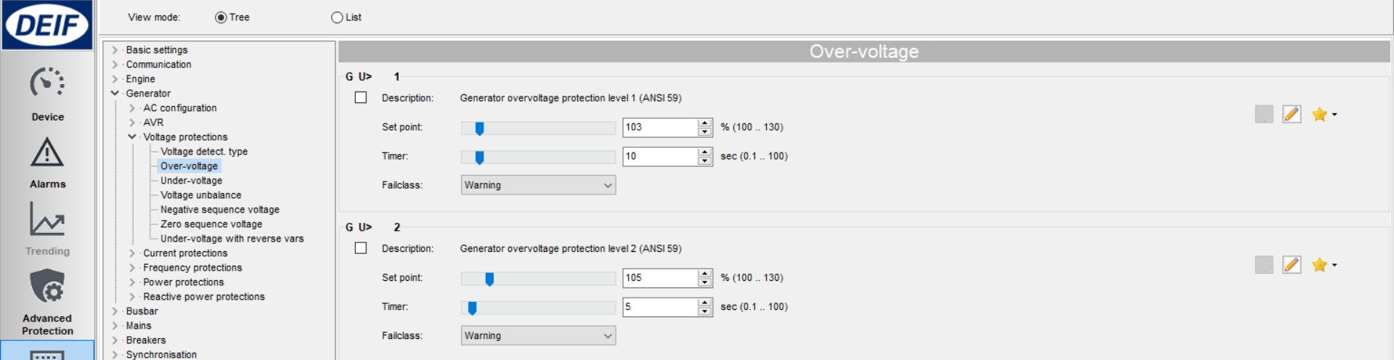
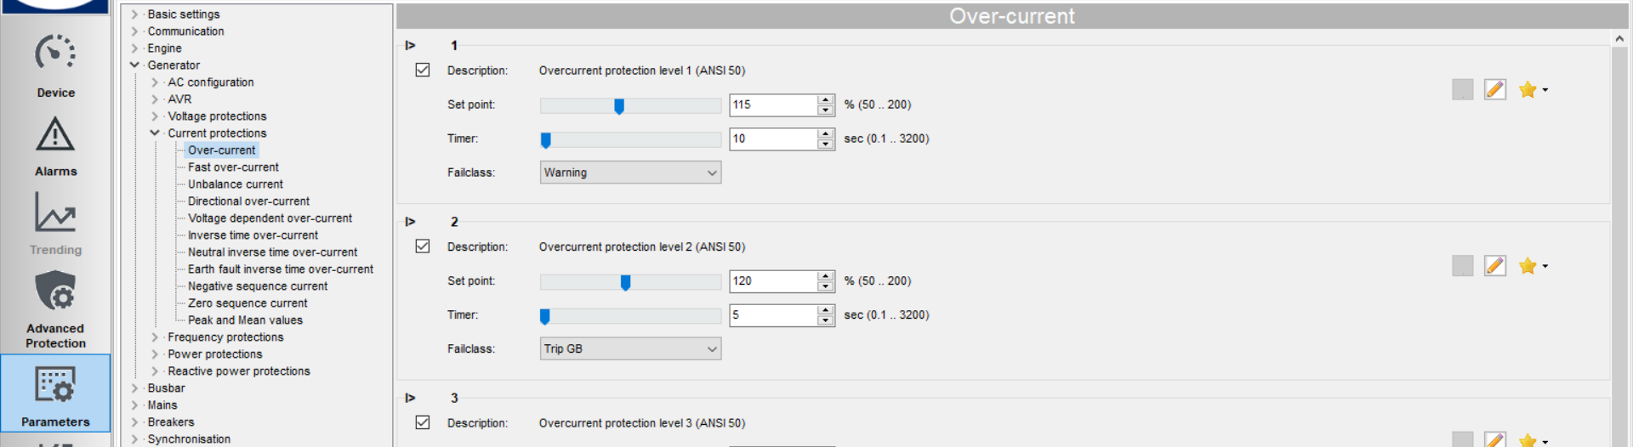
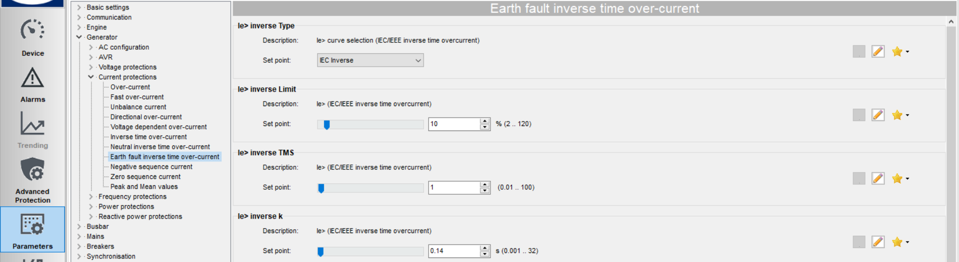
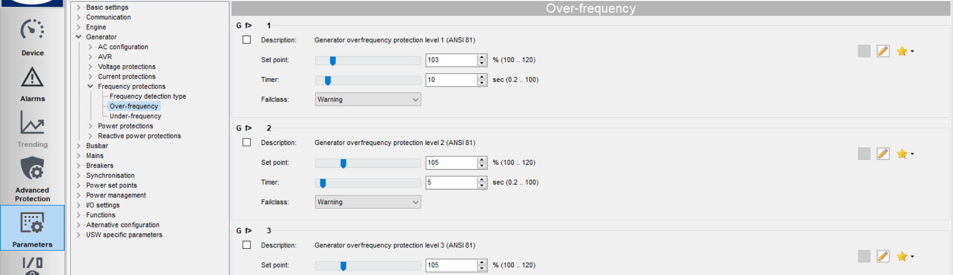
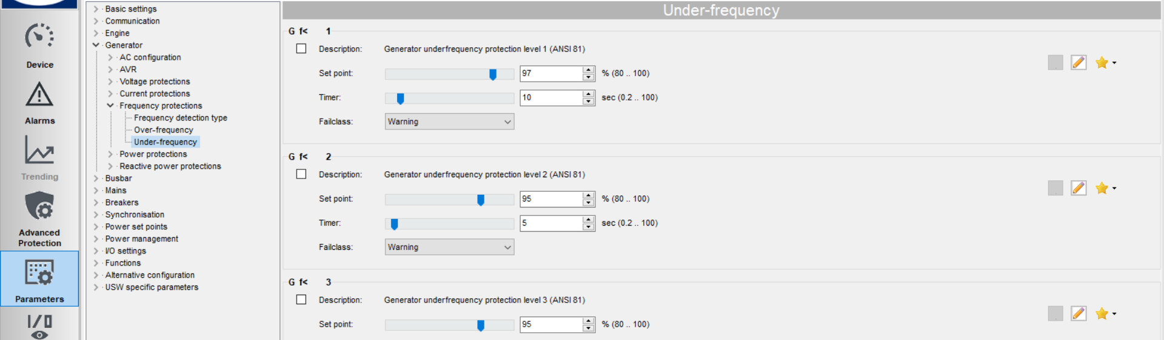
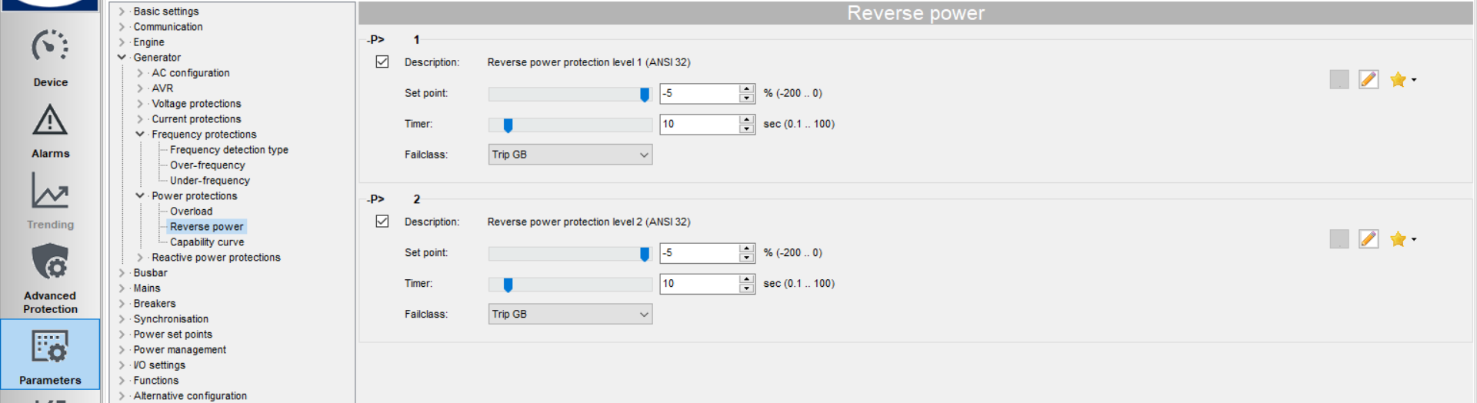
Generator Protection
Checkmark [ √ ] = enable
And many more protections…

Slide 12
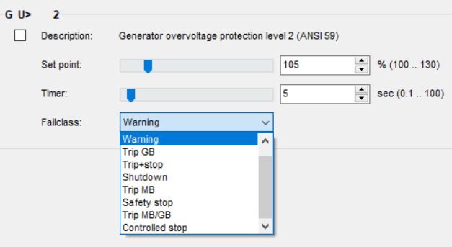
Generator Protection
Fail class:
Trip + stop = GB trip, engine stop after cooling down
Safety stop = Extra genset start up & replace faulty genset
Trip MB/GB = In application “Single DG with mains”, will trip MB instead

Slide 13
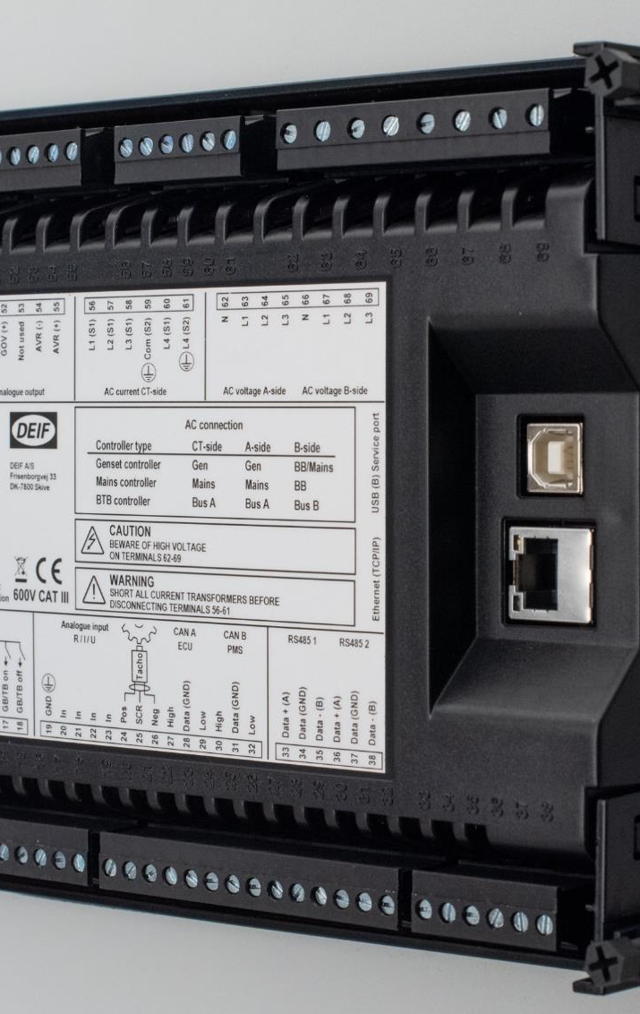
I/O
DIGITAL INPUT
DIGITAL OUTPUT
ANALOG INPUT

Slide 14
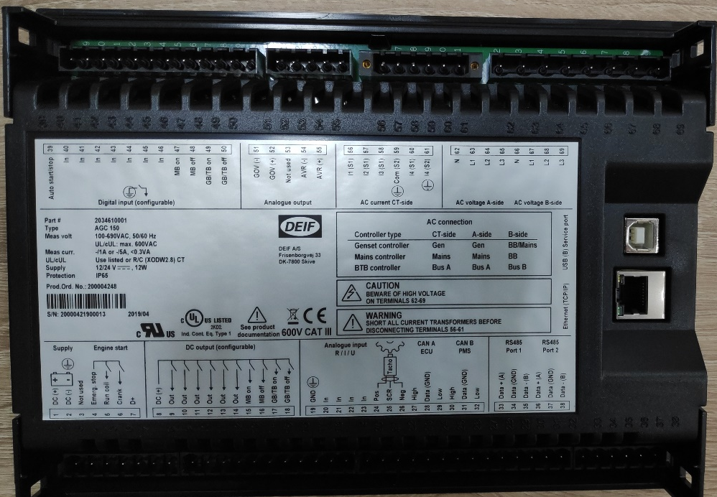
Digital Input
12 digital inputs, activated by negative (-) VDC signal
Each can be configured as:
1. Alarms → setup by Display or USW
2. Function → setup by USW only

Slide 15
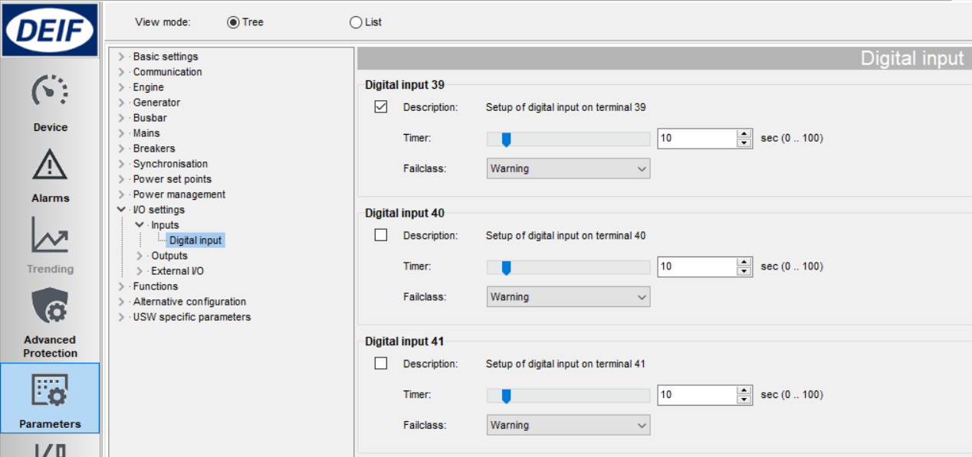
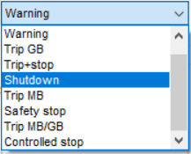
Digital Input
1. Digital input as alarm
Parameter > I/O settings > Inputs > Digital inputs
Set delay
[ √ ] to enable
Action

Slide 16
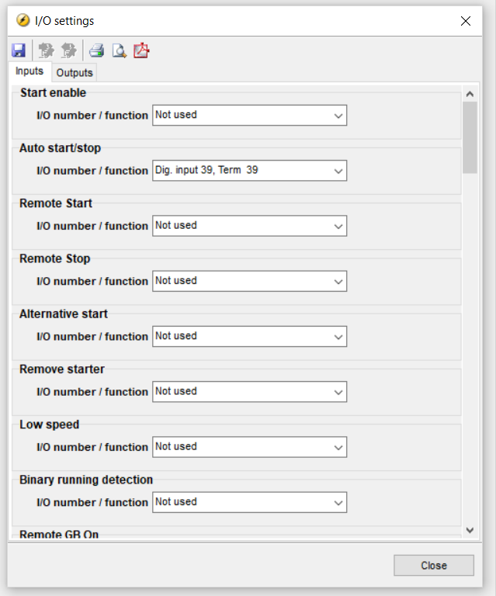
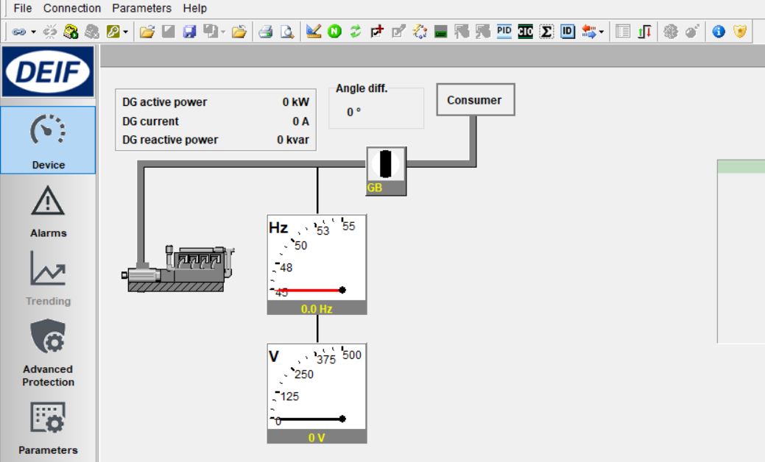
Digital Input
2. Digital input as Function
Click icon I/O settings
Configuration input/output settings

Slide 17
Digital Input
Default assignment
Terminal no. | Function | Remarks
39 | Auto start/stop | For remote start signal
40 | Not used
41 | Not used
42 | Not used
43 | Not used
44 | Not used
45 | Not used
46 | Not used
47 | Status MB ON | For application with Mains
48 | Status MB OFF | For application with Mains
49 | Status GB ON
50 | Status GB OFF

Slide 18
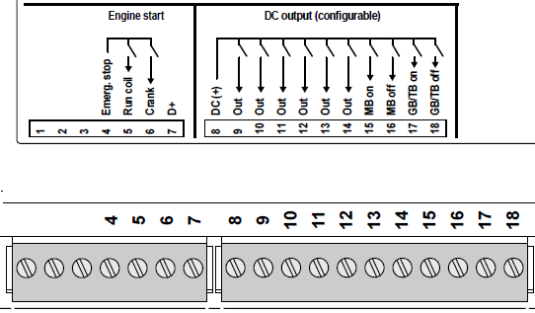
Digital Output
12 digital outputs (DC outputs)
Require common positive (+) VDC
Configuration by USW
(+) VDC

Slide 19
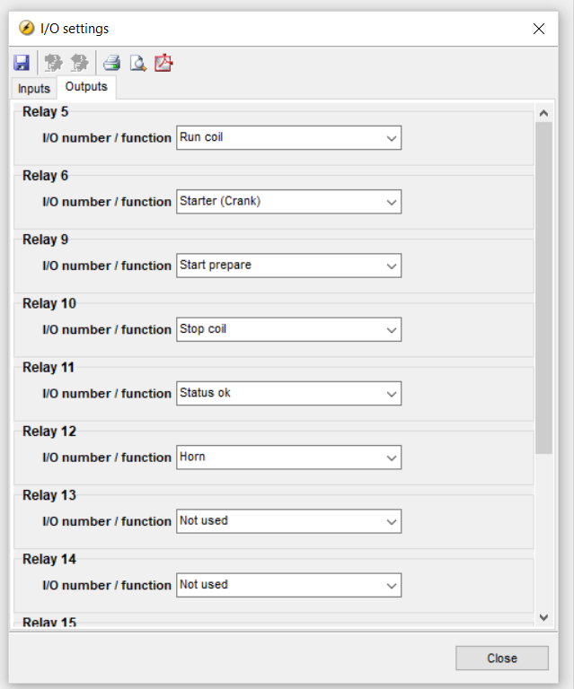
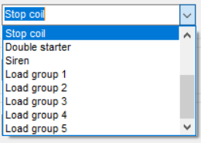
Digital Output
Setup digital output
Click icon I/O settings
Configuration input/output settings

Slide 20
Digital output
Default assignment:
Terminal no. | Function | Remarks
4 | Common (+) for DO 5-6 | Also serves as Emergency stop
5 | Run coil
6 | Starter (crank)
---------------- | --------------------------------- | ---------------------------------------------
8 | Common (+) for DO 9-18
9 | Start prepare
10 | Stop coil
11 | Status OK
12 | Horn
13 | Not used
14 | Not used
15 | MB ON | For application with Mains
16 | MB OFF | For application with Mains
17 | GB ON
18 | GB OFF

Slide 21
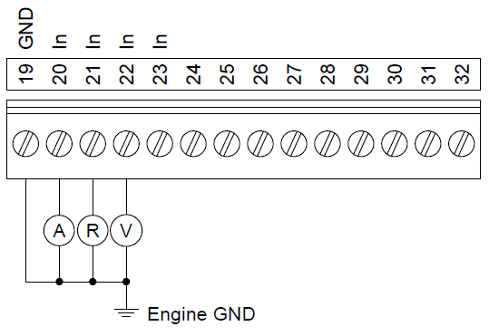
Analog Input
4 multi inputs
Selectable for:
- 4-20 mA - RMI Oil Pressure
- 0-10 VDC - RMI Water Temperature
- PT100 - RMI Fuel Level
- Binary input
Setup by USW

Slide 22
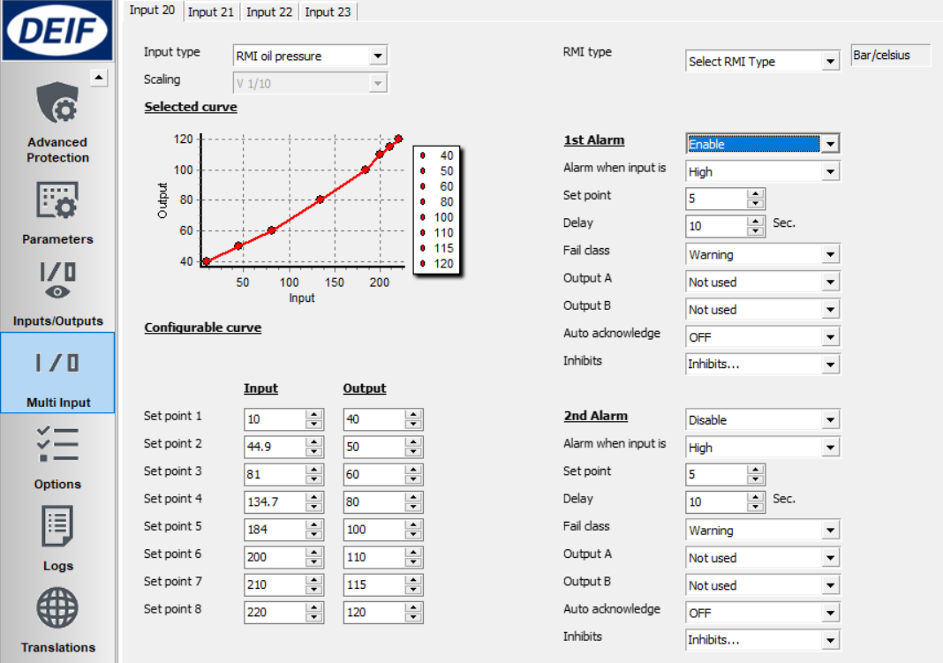
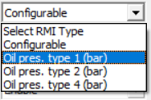
Analog Input
Configuring multi inputs

Slide 23
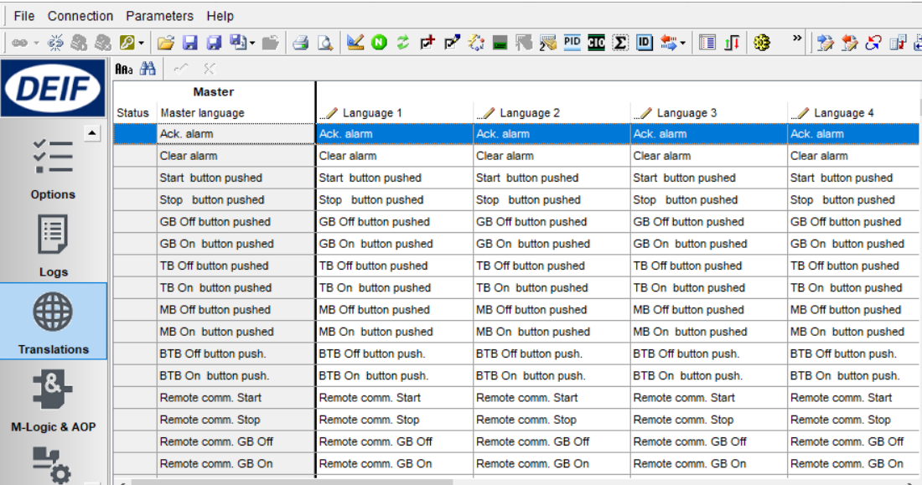
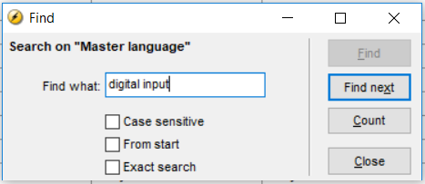
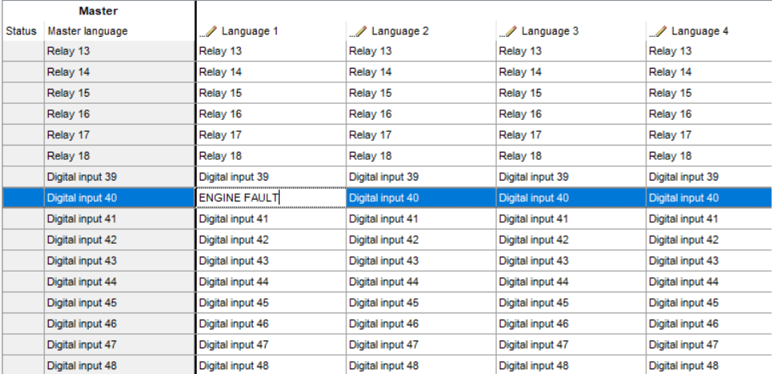
Input & Output Text
To change text, use Translations

Slide 24
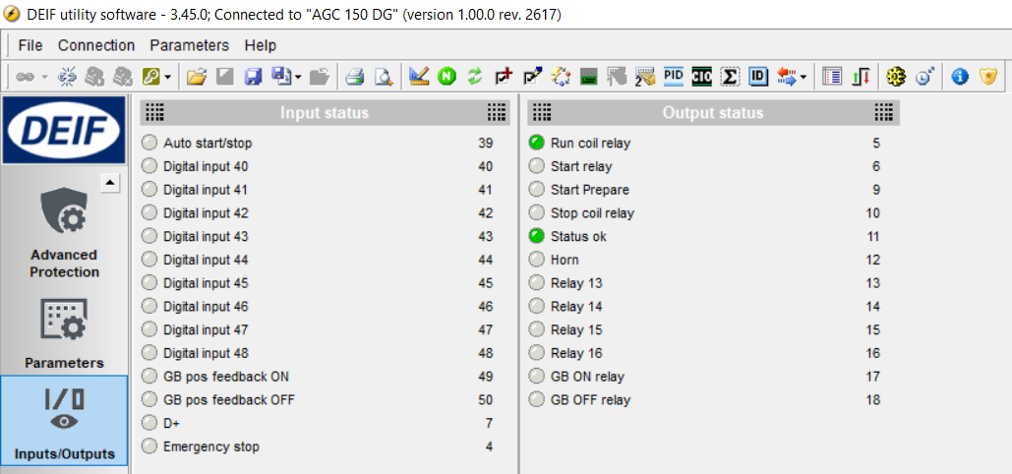
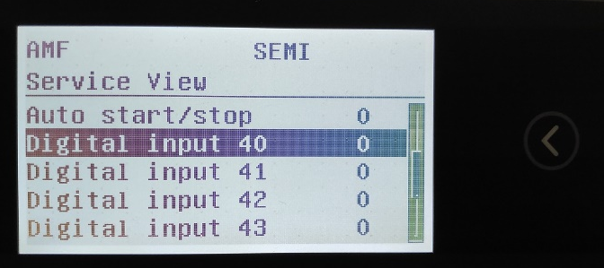
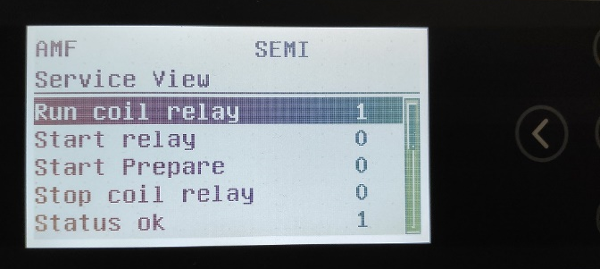
Input & Output Status
Any digital input/output can be monitored trough USW and display

Slide 25
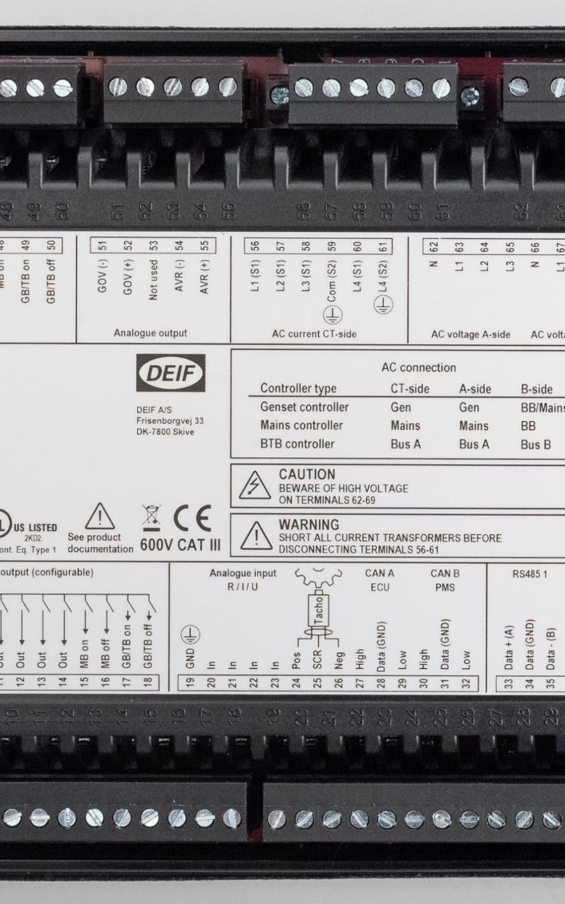
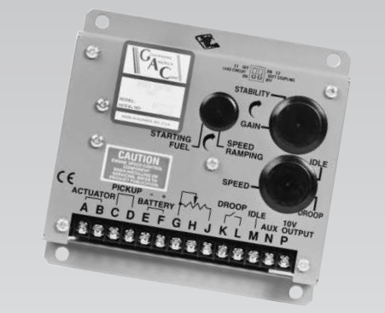
Analog Regulation
SPEED REGULATION - ANALOG
VOLTAGE REGULATION - ANALOG

Slide 26
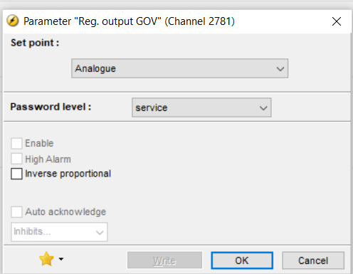
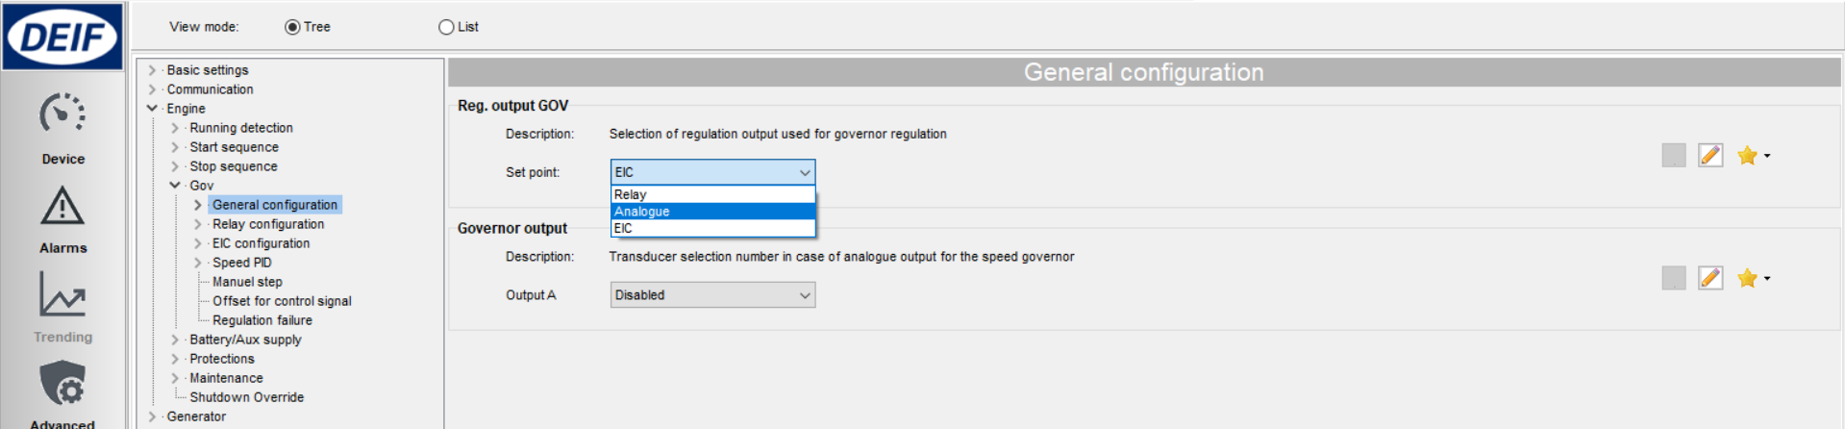
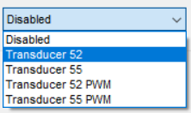
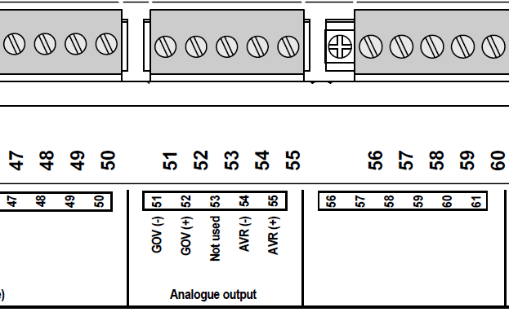
Speed Regulation - Analog
Setup terminal analog output
Parameter > Engine > Gov > General configuration
Set as analog
More setting
Set transducer 52

Slide 27
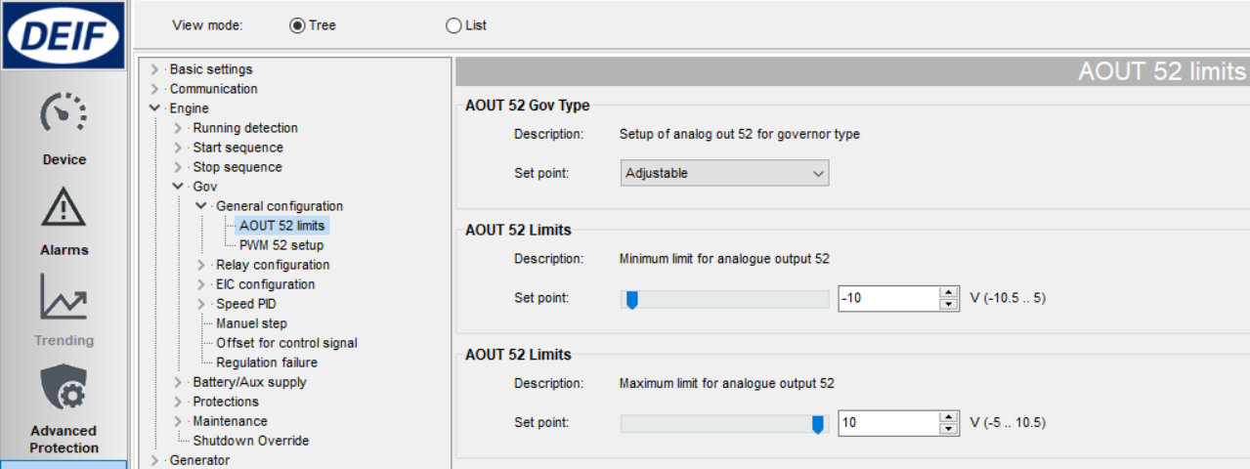


Speed Regulation - Analog
2. Setting analog output range (VDC)
Parameter > Engine > Gov > General configuration > AOUT 52 limits
100 %
10V
50 %
0 %
-10V
GOV

Slide 28

Speed Regulation - Analog
3. Setting offset / center
Parameter > Engine > Gov > Offset for control signal
100 %
10V
50 %
0V
0 %
-10V
GOV

Slide 29

Speed Regulation – Analog Gain
1. PID Island
Parameter > Engine > Gov > Speed PID
> Island (analog/EIC)
Running

Slide 30

Speed Regulation – Analog Gain
2. PID Load sharing
Parameter > Engine > Gov > Speed PID
> Load share (analog/EIC)
other gensets
close

Slide 31

Speed Regulation – Analog Gain
3. PID Mains parallel
Parameter > Engine > Gov > Speed PID
> Mains parallel (analog/EIC)
close

Slide 32


Voltage Regulation - Analog
Setup terminal analog output
Parameter > Generator > AVR > General configuration
More setting

Slide 33


Voltage Regulation - Analog
2. Setting analog output range & center
Parameter > Generator > AVR > General configuration > AOUT 55 limits
Parameter > Generator > AVR > Offset for control signal
100 %
10V
50 %
0V
0 %
-10V
AVR

Slide 34



Voltage Regulation – Analog Gain
Same principle with speed PID
Parameter > Generator > AVR > Voltage PID >
Island (analog/EIC)
Load share (analog/EIC)
Mains parallel (analog/EIC)

Slide 35

Analog Regulation Status
Check Device
> Governor reg.
> AVR reg.

Slide 36

Relay regulation
SPEED REGULATION - RELAY
VOLTAGE REGULATION - RELAY

Slide 37


Speed Regulation - Relay
1. Change Gov setting to relay
Parameter > Engine > Gov > General configuration
Select “Relay”
ignore this part..

Slide 38


Speed Regulation - Relay
2. Setup pulse signal and choosing relay terminals
Parameter > Engine > Gov > Relay configuration > Output and period
Increase
Decrease
Select any unused DO

Slide 39



Speed Regulation - Relay
3. Setup speed Gain
Parameter > Engine > Gov > Speed PID >
Island (relay)
Load share (relay)
Mains Parallel (relay)

Slide 40

Speed Regulation - Relay
Regulation Deadband
When commissioning, set deadband to minimum to check genset response
After completed, set deadband back to prolong relay lifetime
Gov relay inactive inside deadband window
Regulation signal
Signal length depends on the Kp value and size of the deviation.

Slide 41

Voltage Regulation - Relay
1. Change AVR setting to relay
Parameter > Generator > AVR > General configuration
Select “Relay”
ignore this setting

Slide 42

Voltage Regulation - Relay
2. Setup pulse signal and choosing relay terminals
Parameter > Generator > AVR > Relay configuration > Output and period
Relay Increase
Relay Decrease
Select any unused DO

Slide 43



Voltage Regulation - Relay
3. Setup voltage Gain
Parameter > Generator > AVR > Voltage PID >
Island (relay)
Load share (relay)
Mains Parallel (relay)
When commissioning, set deadband to minimum to check genset response
After completed, set deadband back to prolong relay lifetime

Slide 44

Relay Regulation Status
Check Device
> Governor reg.
> AVR reg.

Slide 45
Synchronisation

Slide 46
Synchronisation
AGC always perform synchronism check before closing breakers
All modes: Auto, Semi Auto, and Manual
50.0Hz
Genset should run slightly faster than bus
to avoid reverse power (f gen > f bus)
50.1Hz
√
49.9Hz
Allowed maximum slip frequency: 0.3Hz

Slide 47


Synchronisation
Change slip frequency & voltage
Synchronisation > Dynamic synchronisation
Slip Frequency
Here, to sync with 50.0Hz 400V busbar, genset need to run:
- Freq between 50.0 – 50.3Hz
- Voltage between 380 – 420V
Slip Voltage
Normally no need changing these settings

Slide 48

Application
SINGLE GENSET
MULTIPLE GENSETS

Slide 49







Adapting Mimic
Standalone Island
Standalone AMF
Standalone Parallel without MB
Genset
MAINS+TB
MAINS
BTB

Slide 50





Typical Applications for AGC 150
Single Genset
Single Genset with Mains
Multiple Genset’s with Mains
Mains
Single Genset
Single Genset w. Mains
Genset 1
Genset 2
Genset 3
Genset 32
(SW packagers dependent)

Slide 51
Application
SINGLE GENSET

Slide 52




Single Genset
Application configuration
New plant configuration
Mains
“Single DG”
Single Genset
with Mains

Slide 53

Single Genset
Alternative setup:*
Access from AGC 150 display:
Settings > Basic settings > Application type > Standalone or PM >
> Application select > Active Application
change active application from [1] to [2]
*Only works if application 2 in default factory setting
Application 1
Application 2

Slide 54

Single Genset
Select Genset Mode
Parameter > Basic settings > Application type > Genset type > Genset/plant mode
Example: AMF

Slide 55

Single Genset
Enable Back Synchronising
Parameter > Synchronisation > Mains parallel settings

Slide 56

Single Genset
AMF delay settings
Parameter > Mains > AMF function > AMF timer
Mains failure delay
Mains Ok delay
Modeshift ON: Other modes retain AMF function when Mains fail

Slide 57

Single Genset
Mains failure voltage setpoint
Parameter > Mains > Voltage and frequency limits > Voltage limits

Slide 58

Single Genset
Done setup single genset?
Check Application Supervision

Slide 59

Single Genset
Or Device
For detailed monitoring

Slide 60
Application
MULTIPLE GENSETS

Slide 61



Multiple Gensets
→ Application configuration
→ New plant configuration
Create drawing
of 2 gensets
“Standard”
2 Gensets
Genset 1
Genset 2

Slide 62

Multiple Gensets
Select Genset Mode
Parameter > Basic settings > Application type > Genset type > Genset/plant mode
Load sharing
Power management
Power management
select power management
Genset 1
Genset 2

Slide 63

Multiple Gensets
Setup ID Number
Parameter > Communication > Power management ID
ID: 1
ID: 2
add ID on every genset
Genset 1
Genset 2

Slide 64

Multiple Gensets
CANbus wiring
CAN PMS
put resistor 120 Ω
on both ends
Genset 1
Genset 2

Slide 65

Multiple Gensets
Check Application Supervision
Genset 1
Genset 2
Incorrect communication will be shown

Slide 66

Power Management
LOAD DEPENDENT START/STOP
MULTI START
Genset 1
Genset 2

Slide 67


Load dependent start/stop
Configure Start/stop based on load Percentage
Parameter > Power management > Load dependent start/stop configuration
Set as Percentage
Genset 1
Genset 2

Slide 68

Load dependent start/stop
Start percentage setpoint
Parameter > Power management > Load dependent start 1
Genset 1
Genset 2
Start delay

Slide 69

Load dependent start/stop
Stop percentage setpoint
Parameter > Power management > Load dependent stop 1
% capacity after 1 genset removed
Genset 1
Genset 2
Stopping delay

Slide 70


Multi start
Setup of how many gensets start together
Parameter > Power management > Multi start set
Autostart/stop input
Select Start 2 DG
Start
Start
Genset 1
Genset 2

